Slide 1
Project 4
Team Vega
Brain Stroke Prediction
Hunter S.
Matias L.
Jai’lyn J.
Cassie W.

Slide 2
Our Goals
Read a brain stroke dataset from Kaggle created by medical professionals researching electronic health records for machine learning purposes.
Create our own machine learning processes and run the data through them to analyze their accuracy of predicting both people at risk of a stroke (1), and not at risk (0).
Visualize key factors that may contribute to a person’s risk of a stroke.
Discuss the outcomes of our findings.

Slide 3
What is a brain stroke?
There are two kinds of strokes, ischemic and hemorrhagic.
Ischemic strokes are when the blood supply to the brain is cut off or reduced. 85% of strokes are of this type.
Hemorrhagic strokes are when a blood vessel in the brain bursts or leaks causing bleeding in the brain, causing a stroke. This is also known as a brain hemorrhage.
Strokes affect about 800,000 people annually.
Source: https://www.mayoclinic.org/diseases-conditions/stroke/symptoms-causes/syc-20350113

Slide 4
Who is at risk?
Anyone can suffer from a stroke, but there are factors that can increase that risk.
Age, gender, race, and genetics are all common factors that can impact one’s risk of a stroke.
Drinking, smoking, inactivity, a history of diabetes or heart disease all increase the likelihood of a stroke.
High blood pressure and high cholesterol also increase the risk of strokes.
Source: https://www.mayoclinic.org/diseases-conditions/stroke/symptoms-causes/syc-20350113

Slide 5
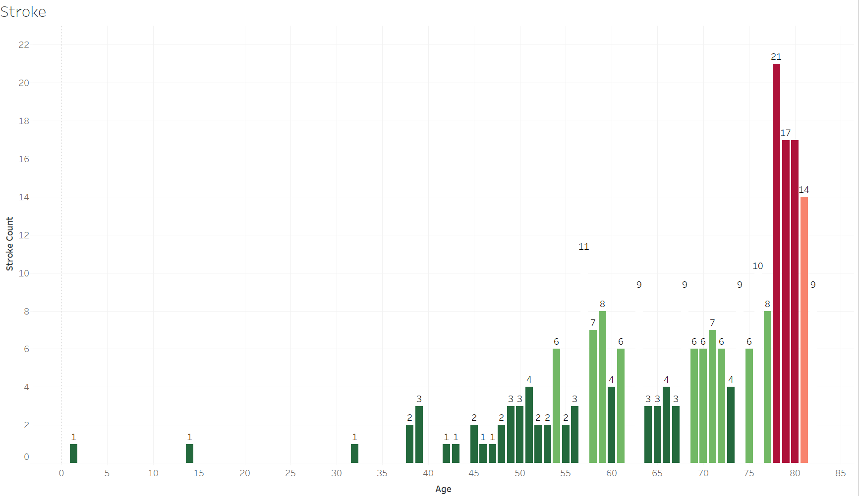
Age as a risk factor
Notes:
According to the CDC, your chances of having a stroke doubles every 10 years after the age of 55.

Slide 6
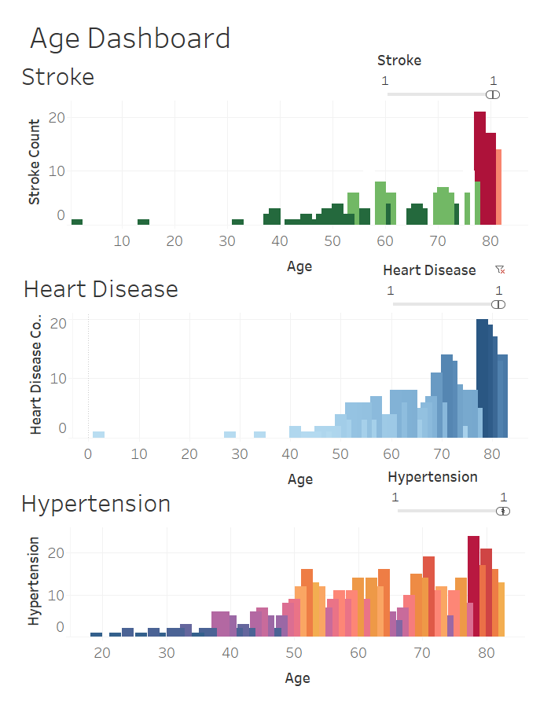
Age as a Risk Factor
Age and other factors also contribute to stroke risk. High blood pressure, a primary cause of stroke, results from elevated pressure in arteries and blood vessels. Heart conditions such as coronary artery disease increase stroke risk by fostering plaque accumulation in arteries, impeding the brain's oxygenated blood supply.

Slide 7
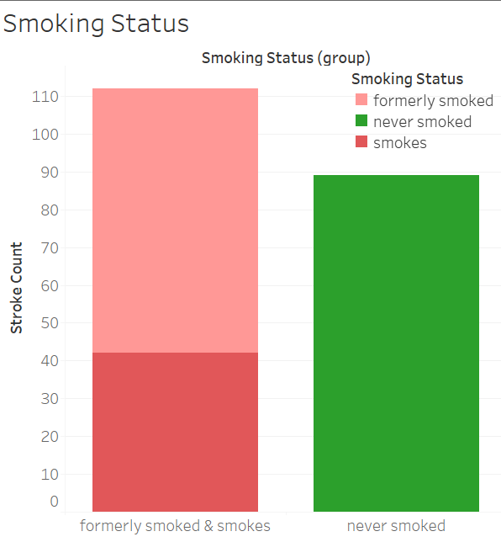
Smoking Status
Smoking tobacco significantly elevates the risk of experiencing a stroke. Individuals who consume 20 cigarettes daily face a six-fold increase in the likelihood of having a stroke compared to those who do not smoke.

Slide 8
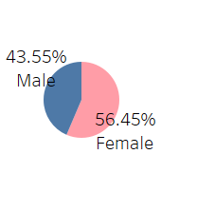
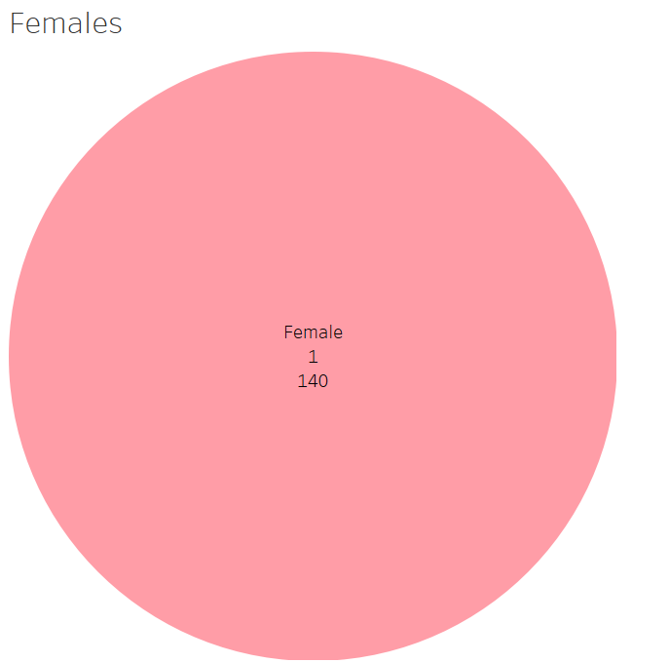
Gender
Out of 248 patients that had a stroke from the data collected, 140 were female. The risk of stroke escalates with advancing age. Given that women typically have longer lifespans than men, a higher proportion of women experience strokes throughout their lives. Additionally, women encounter distinct risk factors for stroke, such as experiencing high blood pressure during pregnancy. The 140 women that had a stroke also have hypertension as well.

Slide 9
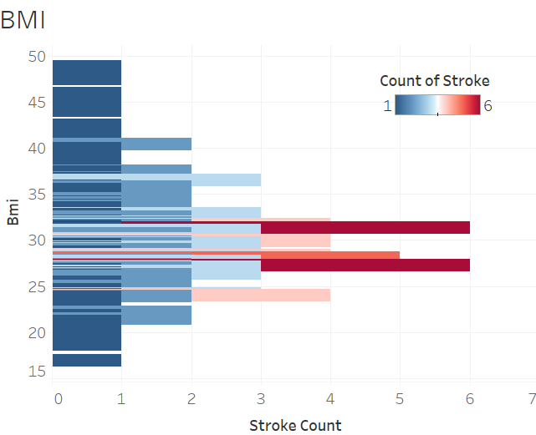
BMI
Being classified as overweight raises your risk of stroke by 22%, while being obese elevates it by 64%. This correlation exists because carrying excess weight heightens the likelihood of developing conditions like high blood pressure, heart disease, high cholesterol, and type 2 diabetes, all of which contribute to an increased risk of stroke.A BMI ranging from 25.0 to less than 30 indicates that you are in the overweight category. If your BMI is 30.0 or higher, you are classified as being in the obesity range.

Slide 10
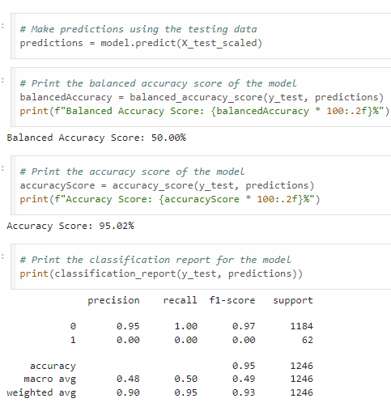
Logistic Regression
The first model that was tested was a Logistic Regression model. The predictions that this model made were compared with the actual dataset to get an accuracy score.
This model had an accuracy of 95.02% and a balanced accuracy of 50%.
This model had a precision of 95% and a recall of 100% for predicting when a patient had not had a stroke, but it had a precision and recall of 0% for predicting when a patient had a stroke.
This model was highly accurate at predicting when a patient had not had a stroke, but inaccurate at predicting when a patient had a stroke.

Slide 11
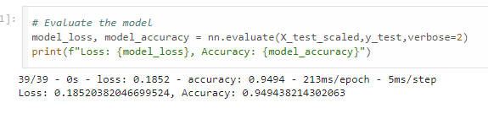
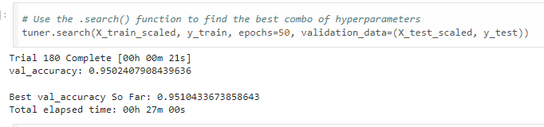
Neural Network
A neural network model was also tested for accuracy.
The initial neural network model was evaluated to be 94.94% accurate and had a loss of 18.52%.
The neural network was then optimized using hypertuning, and a model was created that had an accuracy of 95.1% and 18.28% loss.

Slide 12
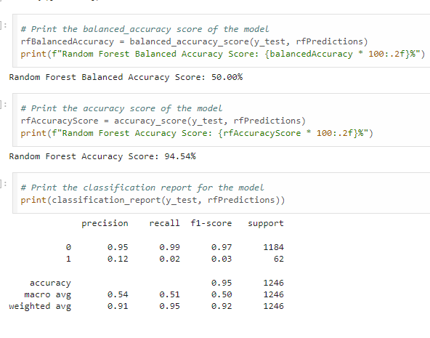
Random Forest
The second model that was tested was a Random Forest Classifier model.
This model had an accuracy of 94.54% and a balanced accuracy of 50%.
This model had similar precision and recall for predicting when a patient had not had a stroke, but had 12% precision and 2% recall for predicting when a patient had a stroke.
This model again made accurate predictions when the patient had not had a stroke and had a small improvement in predicting when the patient had a stroke.

Slide 13
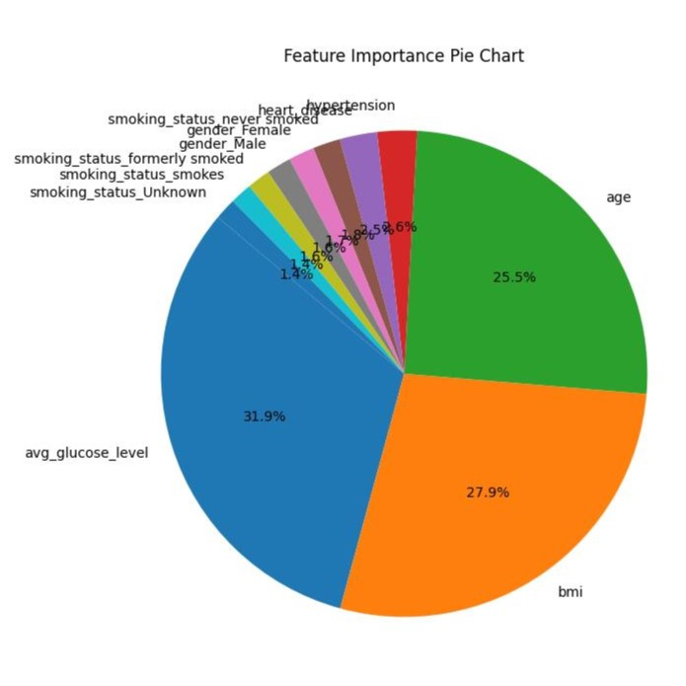
Importances of the data
Using python and the random forest model, a list of importances can be generated, showing the importance of each column of data as they pertain to the machine learning predictions.
From this list, it can be observed that the 3 largest factors that puts one at risk of a stroke (within this data) are average glucose level, a person’s BMI(Body Mass Index), and age.

Slide 14
Outcome & Conclusion
Random forest had the best outcome for accuracy for both risk of a stroke (12%) and not (95%).
The inaccuracy of the not at risk people could be caused by the imbalance of data as there are more not at risk people in the dataset.
Blood sugar, weight, and age are all the largest contributors to one's risk of having a stroke.
Are there any questions?

